Slide 1
8086 Microprocessor
#Education with Values
MAEER's MIT Polytechnic, Department of Information Technology

Slide 2
#Education with Values
MAEER's MIT Polytechnic, Department of Information Technology

Slide 3
Microprocessor
Program controlled semiconductor device (IC) which fetches (from memory), decodes and executes instructions.
It is used as CPU (Central Processing Unit) in computers.
#Education with Values
MAEER's MIT Polytechnic, Department of Information Technology

Slide 4
Microprocessor
Fifth Generation Pentium
Third Generation
During 1978
HMOS technology ⇒ Faster speed, Higher packing density
16 bit processors ⇒ 40/ 48/ 64 pins
Easier to program
Dynamically relatable programs
Processor has multiply/ divide arithmetic hardware
More powerful interrupt handling capabilities
Flexible I/O port addressing
Intel 8086 (16 bit processor)
Fourth Generation
During 1980s
Low power version of HMOS technology (HCMOS)
32 bit processors
Physical memory space 2²⁴ bytes = 16 Mb
Virtual memory space 2⁴⁰ bytes = 1 Tb
Floating point hardware
Supports increased number of addressing modes
Intel 80386
Second Generation
During 1973
NMOS technology ⇒ Faster speed, Higher density, Compatible with TTL
4 / 8/ 16 bit processors ⇒ 40 pins
Ability to address large memory spaces and I/O ports
Greater number of levels of subroutine nesting
Better interrupt handling capabilities
Intel 8085 (8 bit processor)
First Generation
Between 1971 – 1973
PMOS technology, non compatible with TTL
4 bit processors ⇒ 16 pins
8 and 16 bit processors ⇒ 40 pins
Due to limitations of pins, signals are multiplexed
#Education with Values
MAEER's MIT Polytechnic, Department of Information Technology

Slide 5
Functional blocks
Microprocessor
Computational Unit; performs arithmetic and logic operations
Various conditions of the results are stored as status bits called flags in flag register
Internal storage of data
Register array or internal memory
Data Bus
ALU
Generates the address of the instructions to be fetched from the memory and send through address bus to the memory
Flag Register
Instruction decoding unit
Timing and control unit
PC/ IP
Control Bus
Address Bus
Generates control signals for internal and external operations of the microprocessor
Decodes instructions; sends information to the timing and control unit
#Education with Values
MAEER's MIT Polytechnic, Department of Information Technology

Slide 6

Overview
8086 Microprocessor
First 16- bit processor released by INTEL in the year 1978
Originally HMOS, now manufactured using HMOS III technique
Approximately 29, 000 transistors, 40 pin DIP, 5V supply
Does not have internal clock; external asymmetric clock source with 33% duty cycle
20-bit address to access memory ⇒ can address up to 2²⁰ = 1 megabytes of memory space.
Addressable memory space is organized in to two banks of 512 kb each; Even (or lower) bank and Odd (or higher) bank. Address line A₀ is used to select even bank and control signal $\overline{BHE}$
is used to access odd bank
Uses a separate 16 bit address for I/O mapped devices ⇒ can generate 2¹⁶ = 64 k addresses.
Operates in two modes: minimum mode and maximum mode, decided by the signal at MN and $\overline{MX}$ pins.
#Education with Values
MAEER's MIT Polytechnic, Department of Information Technology
Notes:
DIP- Dual Inline Package

Slide 7
Pins and signals
#Education with Values
MAEER's MIT Polytechnic, Department of Information Technology

Slide 8
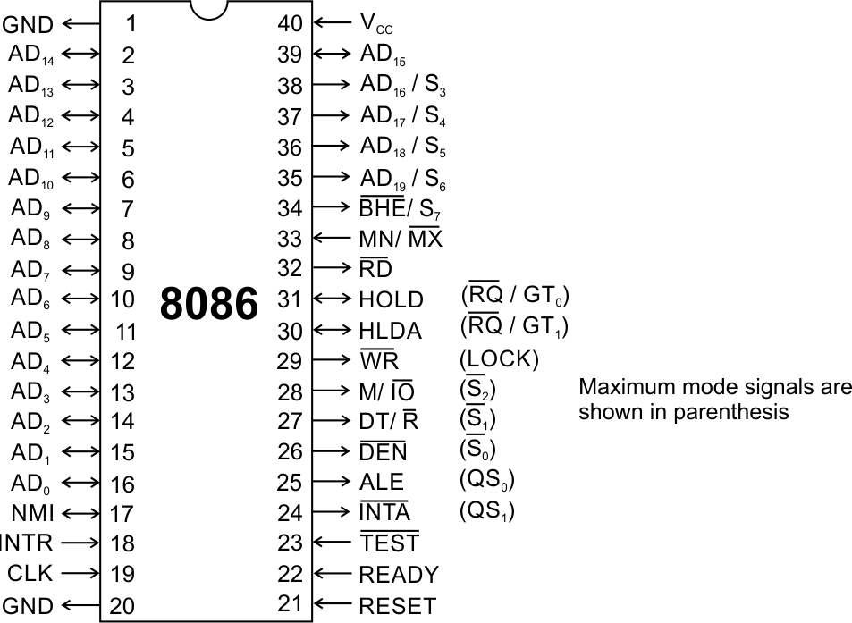
Pins and Signals
8086 Microprocessor
Common signals
AD₀-AD₁₅ (Bidirectional)
Address/Data bus
Low order address bus; these are multiplexed with data.
When AD lines are used to transmit memory address the symbol A is used instead of AD, for example A₀-A₁₅.
When data are transmitted over AD lines the symbol D is used in place of AD, for example D₀-D₇, D₈-D₁₅ or D₀-D₁₅.
A₁₆/S₃, A₁₇/S₄, A₁₈/S₅, A₁₉/S₆
High order address bus. These are multiplexed with status signals
#Education with Values
MAEER's MIT Polytechnic, Department of Information Technology

Slide 9
Pins and Signals
8086 Microprocessor
Common signals
BHE (Active Low)/S₇ (Output)
Bus High Enable/Status
It is used to enable data onto the most significant half of data bus, D₈-D₁₅. 8-bit device connected to upper half of the data bus use BHE (Active Low) signal. It is multiplexed with status signal S₇.
MN/ MX
MINIMUM / MAXIMUM
This pin signal indicates what mode the processor is to operate in.
RD (Read) (Active Low)
The signal is used for read operation.
It is an output signal.
It is active when low.
#Education with Values
MAEER's MIT Polytechnic, Department of Information Technology

Slide 10
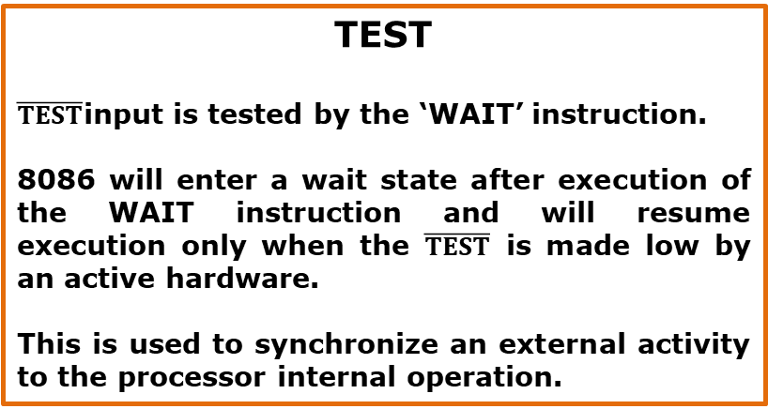
Pins and Signals
8086 Microprocessor
Common signals
TEST
$\overline{TEST}$input is tested by the ‘WAIT’ instruction.
8086 will enter a wait state after execution of the WAIT instruction and will resume execution only when the $\overline{TEST}$ is made low by an active hardware.
This is used to synchronize an external activity to the processor internal operation.
READY
This is the acknowledgement from the slow device or memory that they have completed the data transfer.
The signal made available by the devices is synchronized by the 8284A clock generator to provide ready input to the 8086.
The signal is active high.
#Education with Values
MAEER's MIT Polytechnic, Department of Information Technology

Slide 11
Pins and Signals
8086 Microprocessor
Common signals
RESET (Input)
Causes the processor to immediately terminate its present activity.
The signal must be active HIGH for at least four clock cycles.
CLK
The clock input provides the basic timing for processor operation and bus control activity. Its an asymmetric square wave with 33% duty cycle.
INTR Interrupt Request
This is a triggered input. This is sampled during the last clock cycles of each instruction to determine the availability of the request. If any interrupt request is pending, the processor enters the interrupt acknowledge cycle.
This signal is active high and internally synchronized.
#Education with Values
MAEER's MIT Polytechnic, Department of Information Technology

Slide 12
Pins and Signals
8086 Microprocessor
Min/ Max Pins
The 8086 microprocessor can work in two modes of operations : Minimum mode and Maximum mode.
In the minimum mode of operation the microprocessor do not associate with any co-processors and can not be used for multiprocessor systems.
In the maximum mode the 8086 can work in multi-processor or co-processor configuration.
Minimum or maximum mode operations are decided by the pin MN/ MX(Active low).
When this pin is high 8086 operates in minimum mode otherwise it operates in Maximum mode.
#Education with Values
MAEER's MIT Polytechnic, Department of Information Technology

Slide 13


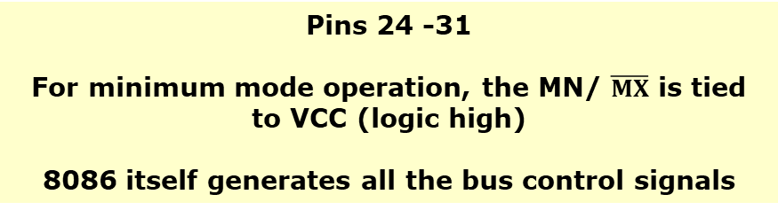

Pins and Signals
8086 Microprocessor
Minimum mode signals
Pins 24 -31
For minimum mode operation, the MN/ $\overline{MX}$ is tied to VCC (logic high)
8086 itself generates all the bus control signals
DT/$\overline{R}$ | (Data Transmit/ Receive) Output signal from the processor to control the direction of data flow through the data transceivers
$$\overline{DEN}$$ | (Data Enable) Output signal from the processor used as out put enable for the transceivers
ALE | (Address Latch Enable) Used to demultiplex the address and data lines using external latches
M/$\overline{IO}$ | Used to differentiate memory access and I/O access. For memory reference instructions, it is high. For IN and OUT instructions, it is low.
$$\overline{WR}$$ | Write control signal; asserted low Whenever processor writes data to memory or I/O port
$$\overline{INTA}$$ | (Interrupt Acknowledge) When the interrupt request is accepted by the processor, the output is low on this line.
#Education with Values
MAEER's MIT Polytechnic, Department of Information Technology

Slide 14
Pins and Signals
8086 Microprocessor
Minimum mode signals
Pins 24 -31
For minimum mode operation, the MN/ $\overline{MX}$ is tied to VCC (logic high)
8086 itself generates all the bus control signals
HOLD | Input signal to the processor form the bus masters as a request to grant the control of the bus. Usually used by the DMA controller to get the control of the bus.
HLDA | (Hold Acknowledge) Acknowledge signal by the processor to the bus master requesting the control of the bus through HOLD. The acknowledge is asserted high, when the processor accepts HOLD.
#Education with Values
MAEER's MIT Polytechnic, Department of Information Technology

Slide 15
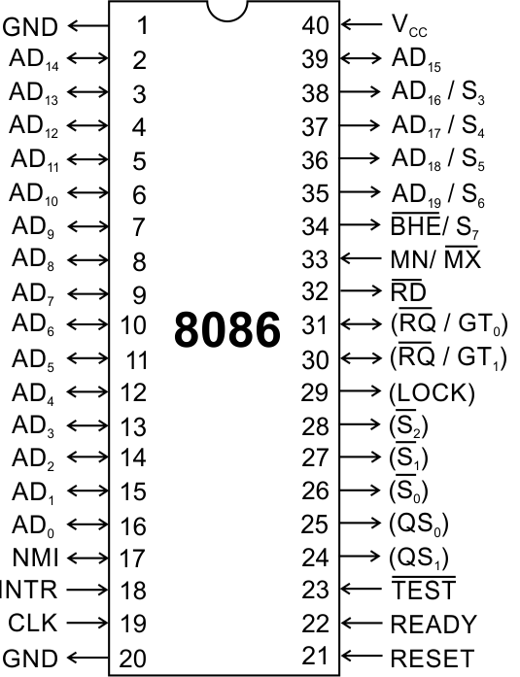
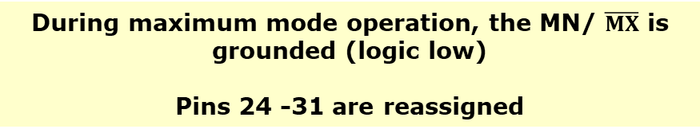
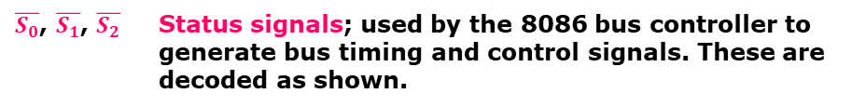
Pins and Signals
8086 Microprocessor
Maximum mode signals
During maximum mode operation, the MN/ $\overline{MX}$ is grounded (logic low)
Pins 24 -31 are reassigned
$\overline{S_{0}}$, $\overline{S_{1}}$, $\overline{S_{2}}$ | Status signals; used by the 8086 bus controller to generate bus timing and control signals. These are decoded as shown.
#Education with Values
MAEER's MIT Polytechnic, Department of Information Technology

Slide 16
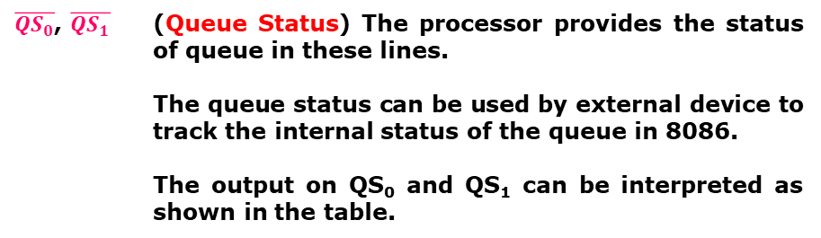
Pins and Signals
8086 Microprocessor
Maximum mode signals
During maximum mode operation, the MN/ $\overline{MX}$ is grounded (logic low)
Pins 24 -31 are reassigned
$\overline{{QS}_{0}}$, $\overline{QS_{1}}$ | (Queue Status) The processor provides the status of queue in these lines. The queue status can be used by external device to track the internal status of the queue in 8086. The output on QS₀ and QS₁ can be interpreted as shown in the table.
#Education with Values
MAEER's MIT Polytechnic, Department of Information Technology

Slide 17
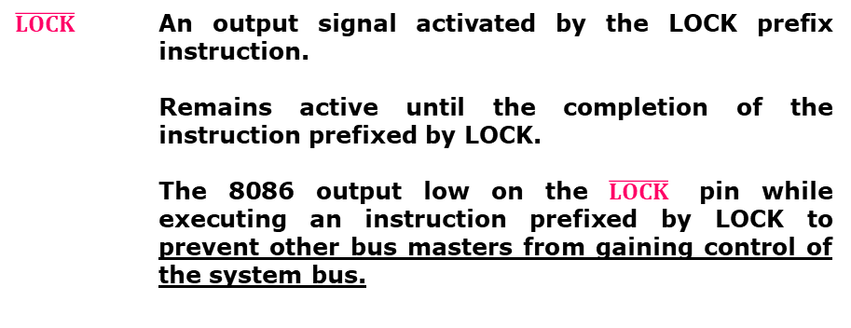
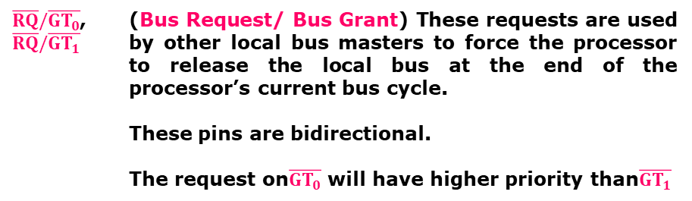
Pins and Signals
8086 Microprocessor
Maximum mode signals
During maximum mode operation, the MN/ $\overline{MX}$ is grounded (logic low)
Pins 24 -31 are reassigned
$\overline{RQ}/\overline{GT_{0}}$, $\overline{RQ}/\overline{GT_{1}}$ | (Bus Request/ Bus Grant) These requests are used by other local bus masters to force the processor to release the local bus at the end of the processor’s current bus cycle. These pins are bidirectional. The request on$\overline{GT_{0}}$ will have higher priority than$\overline{GT_{1}}$
$$\overline{LOCK}$$ | An output signal activated by the LOCK prefix instruction. Remains active until the completion of the instruction prefixed by LOCK. The 8086 output low on the $\overline{LOCK}$ pin while executing an instruction prefixed by LOCK to prevent other bus masters from gaining control of the system bus.
#Education with Values
MAEER's MIT Polytechnic, Department of Information Technology

Slide 18
Architecture
#Education with Values
MAEER's MIT Polytechnic, Department of Information Technology

Slide 19
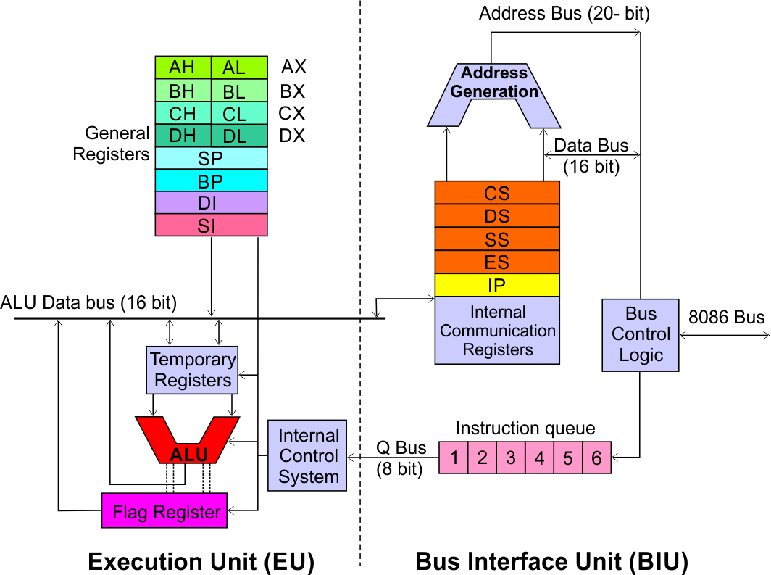
Architecture
8086 Microprocessor
Execution Unit (EU)
EU executes instructions that have already been fetched by the BIU.
BIU and EU functions separately.
Bus Interface Unit (BIU)
BIU fetches instructions, reads data from memory and I/O ports, writes data to memory and I/ O ports.
#Education with Values
MAEER's MIT Polytechnic, Department of Information Technology

Slide 20
Architecture
8086 Microprocessor
Bus Interface Unit (BIU)
Dedicated Adder to generate 20 bit address
Four 16-bit segment registers
Code Segment (CS)
Data Segment (DS)
Stack Segment (SS)
Extra Segment (ES)
#Education with Values
Segment Registers >>
MAEER's MIT Polytechnic, Department of Information Technology

Slide 21
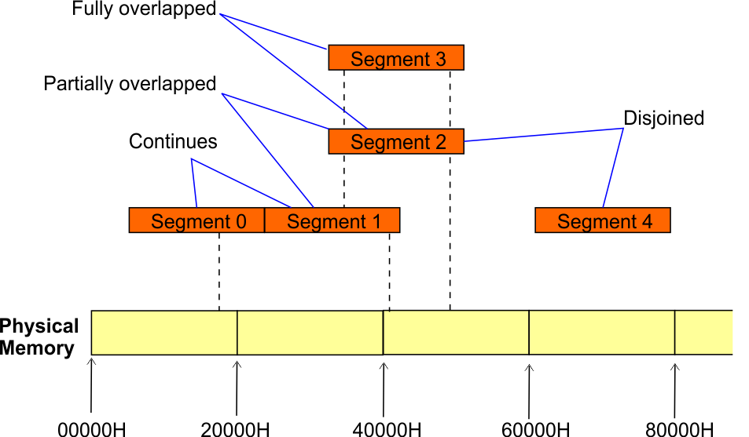
Architecture
8086 Microprocessor
Bus Interface Unit (BIU)
Segment
Registers
8086’s 1-megabyte memory is divided into segments of up to 64K bytes each.
The 8086 can directly address four segments (256 K bytes within the 1 M byte of memory) at a particular time.
Programs obtain access to code and data in the segments by changing the segment register content to point to the desired segments.
#Education with Values
MAEER's MIT Polytechnic, Department of Information Technology

Slide 22
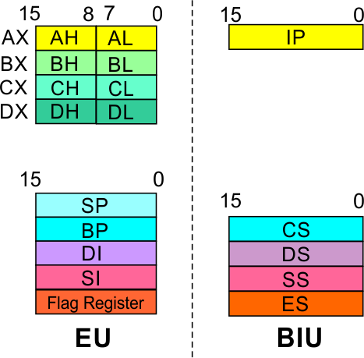
Architecture
8086 Microprocessor
Bus Interface Unit (BIU)
Segment
Registers
Code Segment Register
16-bit
CS contains the base or start of the current code segment; IP contains the distance or offset from this address to the next instruction byte to be fetched.
BIU computes the 20-bit physical address by logically shifting the contents of CS 4-bits to the left and then adding the 16-bit contents of IP.
That is, all instructions of a program are relative to the contents of the CS register multiplied by 16 and then offset is added provided by the IP.
#Education with Values
MAEER's MIT Polytechnic, Department of Information Technology

Slide 23
Architecture
8086 Microprocessor
Bus Interface Unit (BIU)
Segment
Registers
Data Segment Register
16-bit
Points to the current data segment; operands for most instructions are fetched from this segment.
The 16-bit contents of the Source Index (SI) or Destination Index (DI) or a 16-bit displacement are used as offset for computing the 20-bit physical address.
#Education with Values
MAEER's MIT Polytechnic, Department of Information Technology

Slide 24
Architecture
8086 Microprocessor
Bus Interface Unit (BIU)
Segment
Registers
Stack Segment Register
16-bit
Points to the current stack.
The 20-bit physical stack address is calculated from the Stack Segment (SS) and the Stack Pointer (SP) for stack instructions such as PUSH and POP.
In based addressing mode, the 20-bit physical stack address is calculated from the Stack segment (SS) and the Base Pointer (BP).
#Education with Values
MAEER's MIT Polytechnic, Department of Information Technology

Slide 25
Architecture
8086 Microprocessor
Bus Interface Unit (BIU)
Segment
Registers
Extra Segment Register
16-bit
Points to the extra segment in which data (in excess of 64K pointed to by the DS) is stored.
String instructions use the ES and DI to determine the 20-bit physical address for the destination.
#Education with Values
MAEER's MIT Polytechnic, Department of Information Technology

Slide 26
Architecture
8086 Microprocessor
Bus Interface Unit (BIU)
Segment
Registers
Instruction Pointer
16-bit
Always points to the next instruction to be executed within the currently executing code segment.
So, this register contains the 16-bit offset address pointing to the next instruction code within the 64Kb of the code segment area.
Its content is automatically incremented as the execution of the next instruction takes place.
#Education with Values
MAEER's MIT Polytechnic, Department of Information Technology

Slide 27
Architecture
8086 Microprocessor
Bus Interface Unit (BIU)
Instruction queue
A group of First-In-First-Out (FIFO) in which up to 6 bytes of instruction code are pre fetched from the memory ahead of time.
This is done in order to speed up the execution by overlapping instruction fetch with execution.
This mechanism is known as pipelining.
#Education with Values
MAEER's MIT Polytechnic, Department of Information Technology

Slide 28
Architecture
8086 Microprocessor
Execution Unit (EU)
EU decodes and executes instructions.
A decoder in the EU control system translates instructions.
16-bit ALU for performing arithmetic and logic operation
Four general purpose registers(AX, BX, CX, DX);
Pointer registers (Stack Pointer, Base Pointer);
and
Index registers (Source Index, Destination Index) each of 16-bits
Some of the 16 bit registers can be used as two 8 bit registers as :
AX can be used as AH and AL
BX can be used as BH and BL
CX can be used as CH and CL
DX can be used as DH and DL
#Education with Values
MAEER's MIT Polytechnic, Department of Information Technology

Slide 29
Architecture
8086 Microprocessor
Execution Unit (EU)
EU
Registers
Accumulator Register (AX)
Consists of two 8-bit registers AL and AH, which can be combined together and used as a 16-bit register AX.
AL in this case contains the low order byte of the word, and AH contains the high-order byte.
The I/O instructions use the AX or AL for inputting / outputting 16 or 8 bit data to or from an I/O port.
Multiplication and Division instructions also use the AX or AL.
#Education with Values
MAEER's MIT Polytechnic, Department of Information Technology

Slide 30
Architecture
8086 Microprocessor
Execution Unit (EU)
EU
Registers
Base Register (BX)
Consists of two 8-bit registers BL and BH, which can be combined together and used as a 16-bit register BX.
BL in this case contains the low-order byte of the word, and BH contains the high-order byte.
This is the only general purpose register whose contents can be used for addressing the 8086 memory.
All memory references utilizing this register content for addressing use DS as the default segment register.
#Education with Values
MAEER's MIT Polytechnic, Department of Information Technology

Slide 31
Architecture
8086 Microprocessor
Execution Unit (EU)
EU
Registers
Counter Register (CX)
Consists of two 8-bit registers CL and CH, which can be combined together and used as a 16-bit register CX.
When combined, CL register contains the low order byte of the word, and CH contains the high-order byte.
Instructions such as SHIFT, ROTATE and LOOP use the contents of CX as a counter.
Example:
The instruction LOOP START automatically decrements CX by 1 without affecting flags and will check if [CX] = 0.
If it is zero, 8086 executes the next instruction; otherwise the 8086 branches to the label START.
#Education with Values
MAEER's MIT Polytechnic, Department of Information Technology

Slide 32
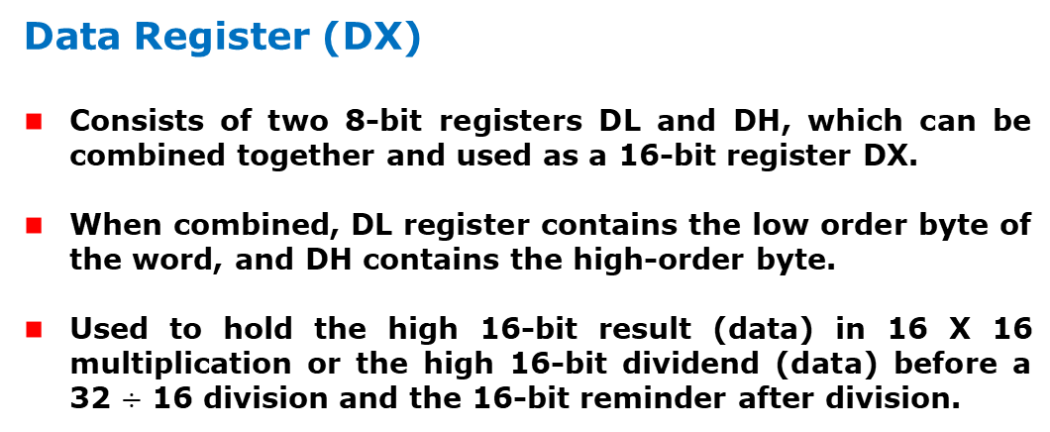
Architecture
8086 Microprocessor
Execution Unit (EU)
EU
Registers
Data Register (DX)
Consists of two 8-bit registers DL and DH, which can be combined together and used as a 16-bit register DX.
When combined, DL register contains the low order byte of the word, and DH contains the high-order byte.
Used to hold the high 16-bit result (data) in 16 X 16 multiplication or the high 16-bit dividend (data) before a 32 $÷$ 16 division and the 16-bit reminder after division.
#Education with Values
MAEER's MIT Polytechnic, Department of Information Technology

Slide 33
Architecture
8086 Microprocessor
Execution Unit (EU)
EU
Registers
Stack Pointer (SP) and Base Pointer (BP)
SP and BP are used to access data in the stack segment.
SP is used as an offset from the current SS during execution of instructions that involve the stack segment in the external memory.
SP contents are automatically updated (incremented/ decremented) due to execution of a POP or PUSH instruction.
BP contains an offset address in the current SS, which is used by instructions utilizing the based addressing mode.
#Education with Values
MAEER's MIT Polytechnic, Department of Information Technology

Slide 34
Architecture
8086 Microprocessor
Execution Unit (EU)
EU
Registers
Source Index (SI) and Destination Index (DI)
Used in indexed addressing.
Instructions that process data strings use the SI and DI registers together with DS and ES respectively in order to distinguish between the source and destination addresses.
#Education with Values
MAEER's MIT Polytechnic, Department of Information Technology

Slide 35
Architecture
8086 Microprocessor
Execution Unit (EU)
EU
Registers
Source Index (SI) and Destination Index (DI)
Used in indexed addressing.
Instructions that process data strings use the SI and DI registers together with DS and ES respectively in order to distinguish between the source and destination addresses.
#Education with Values
MAEER's MIT Polytechnic, Department of Information Technology

Slide 36
Architecture
8086 Microprocessor
Execution Unit (EU)
Auxiliary Carry Flag
This is set, if there is a carry from the lowest nibble, i.e, bit three during addition, or borrow for the lowest nibble, i.e, bit three, during subtraction.
Carry Flag
This flag is set, when there is a carry out of MSB in case of addition or a borrow in case of subtraction.
Flag Register
Sign Flag
This flag is set, when the result of any computation is negative
Zero Flag
This flag is set, if the result of the computation or comparison performed by an instruction is zero
Parity Flag
This flag is set to 1, if the lower byte of the result contains even number of 1’s ; for odd number of 1’s set to zero.
15 | 14 | 13 | 12 | 11 | 10 | 9 | 8 | 7 | 6 | 5 | 4 | 3 | 2 | 1 | 0
 |  |  |  | OF | DF | IF | TF | SF | ZF |  | AF |  | PF |  | CF
Over flow Flag
This flag is set, if an overflow occurs, i.e, if the result of a signed operation is large enough to accommodate in a destination register. The result is of more than 7-bits in size in case of 8-bit signed operation and more than 15-bits in size in case of 16-bit sign operations, then the overflow will be set.
Tarp Flag
If this flag is set, the processor enters the single step execution mode by generating internal interrupts after the execution of each instruction
Direction Flag
This is used by string manipulation instructions. If this flag bit is ‘0’, the string is processed beginning from the lowest address to the highest address, i.e., auto incrementing mode. Otherwise, the string is processed from the highest address towards the lowest address, i.e., auto incrementing mode.
Interrupt Flag
Causes the 8086 to recognize external mask interrupts; clearing IF disables these interrupts.

Slide 37
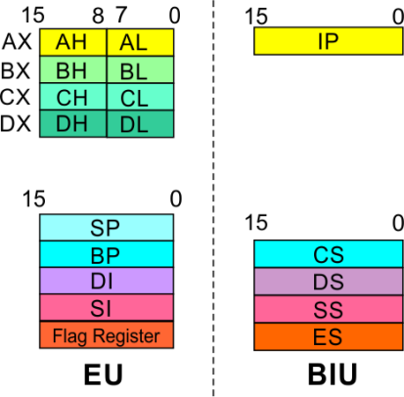
8086 Microprocessor
Architecture
8086 registers categorized into 4 groups
15 | 14 | 13 | 12 | 11 | 10 | 9 | 8 | 7 | 6 | 5 | 4 | 3 | 2 | 1 | 0
 |  |  |  | OF | DF | IF | TF | SF | ZF |  | AF |  | PF |  | CF
Sl.No. | Type | Register width | Name of register
1 | General purpose register | 16 bit | AX, BX, CX, DX
 |  | 8 bit | AL, AH, BL, BH, CL, CH, DL, DH
2 | Pointer register | 16 bit | SP, BP
3 | Index register | 16 bit | SI, DI
4 | Instruction Pointer | 16 bit | IP
5 | Segment register | 16 bit | CS, DS, SS, ES
6 | Flag (PSW) | 16 bit | Flag register
#Education with Values
MAEER's MIT Polytechnic, Department of Information Technology

Slide 38
8086 Microprocessor
Architecture
Registers and Special Functions
Register | Name of the Register | Special Function
AX | 16-bit Accumulator | Stores the 16-bit results of arithmetic and logic operations
AL | 8-bit Accumulator | Stores the 8-bit results of arithmetic and logic operations
BX | Base register | Used to hold base value in base addressing mode to access memory data
CX | Count Register | Used to hold the count value in SHIFT, ROTATE and LOOP instructions
DX | Data Register | Used to hold data for multiplication and division operations
SP | Stack Pointer | Used to hold the offset address of top stack memory
BP | Base Pointer | Used to hold the base value in base addressing using SS register to access data from stack memory
SI | Source Index | Used to hold index value of source operand (data) for string instructions
DI | Data Index | Used to hold the index value of destination operand (data) for string operations
#Education with Values
MAEER's MIT Polytechnic, Department of Information Technology

Slide 39
ADDRESSING MODES
&
Instruction set
#Education with Values
MAEER's MIT Polytechnic, Department of Information Technology

Slide 40
Introduction
8086 Microprocessor
Program
A set of instructions written to solve a problem.
Instruction
Directions which a microprocessor follows to execute a task or part of a task.
Computer language
High Level
Low Level
Machine Language
Assembly Language
 Binary bits
English Alphabets
‘Mnemonics’
Assembler Mnemonics → Machine Language
#Education with Values
MAEER's MIT Polytechnic, Department of Information Technology

Slide 41
Introduction
8086 Microprocessor
Program is a set of instructions written to solve a problem. Instructions are the directions which a microprocessor follows to execute a task or part of a task. Broadly, computer language can be divided into two parts as high-level language and low level language. Low level language are machine specific. Low level language can be further divided into machine language and assembly language.
Machine language is the only language which a machine can understand. Instructions in this language are written in binary bits as a specific bit pattern. The computer interprets this bit pattern as an instruction to perform a particular task. The entire program is a sequence of binary numbers. This is a machine-friendly language but not user friendly. Debugging is another problem associated with machine language.
To overcome these problems, programmers develop another way in which instructions are written in English alphabets. This new language is known as Assembly language. The instructions in this language are termed mnemonics. As microprocessor can only understand the machine language so mnemonics are translated into machine language either manually or by a program known as assembler.
Efficient software development for the microprocessor requires a complete familiarity with the instruction set, their format and addressing modes. Here in this chapter, we will focus on the addressing modes and instructions formats of microprocessor 8086.
#Education with Values
MAEER's MIT Polytechnic, Department of Information Technology

Slide 42
ADDRESSING MODES
#Education with Values
MAEER's MIT Polytechnic, Department of Information Technology

Slide 43
Addressing Modes
8086 Microprocessor
Every instruction of a program has to operate on a data.
The different ways in which a source operand is denoted in an instruction are known as addressing modes.
Register Addressing
Immediate Addressing
Direct Addressing
Register Indirect Addressing
Based Addressing
Indexed Addressing
Based Index Addressing
String Addressing
Direct I/O port Addressing
10. Indirect I/O port Addressing
11. Relative Addressing
12. Implied Addressing
Group I : Addressing modes for register and immediate data
Group II : Addressing modes for memory data
Group III : Addressing modes for I/O ports
Group IV : Relative Addressing mode
#Education with Values
Group V : Implied Addressing mode
MAEER's MIT Polytechnic, Department of Information Technology

Slide 44
Addressing Modes
8086 Microprocessor
Group I : Addressing modes for register and immediate data
Register Addressing
Immediate Addressing
Direct Addressing
Register Indirect Addressing
Based Addressing
Indexed Addressing
Based Index Addressing
String Addressing
Direct I/O port Addressing
10. Indirect I/O port Addressing
11. Relative Addressing
12. Implied Addressing
The instruction will specify the name of the register which holds the data to be operated by the instruction.
Example:
MOV CL, DH
The content of 8-bit register DH is moved to another 8-bit register CL
(CL) ← (DH)
#Education with Values
MAEER's MIT Polytechnic, Department of Information Technology

Slide 45

Addressing Modes
8086 Microprocessor
Group I : Addressing modes for register and immediate data
Register Addressing
Immediate Addressing
Direct Addressing
Register Indirect Addressing
Based Addressing
Indexed Addressing
Based Index Addressing
String Addressing
Direct I/O port Addressing
10. Indirect I/O port Addressing
11. Relative Addressing
12. Implied Addressing
In immediate addressing mode, an 8-bit or 16-bit data is specified as part of the instruction
Example:
MOV DL, 08H
The 8-bit data (08_{H}) given in the
instruction is moved to DL
(DL) ← 08_{H}
MOV AX, 0A9FH
The 16-bit data (0A9F_{H}) given in the
instruction is moved to AX register
(AX) ← 0A9F_{H}
#Education with Values
MAEER's MIT Polytechnic, Department of Information Technology

Slide 46
Addressing Modes : Memory Access
8086 Microprocessor
Offset Value (16 bits)
Segment Register (16 bits)
0 0 0 0
Adder
Physical Address (20 Bits)
#Education with Values
MAEER's MIT Polytechnic, Department of Information Technology

Slide 47
Addressing Modes : Memory Access
8086 Microprocessor
20 Address lines ⇒ 8086 can address up to 2²⁰ = 1M bytes of memory
However, the largest register is only 16 bits
Physical Address will have to be calculated Physical Address : Actual address of a byte in memory. i.e. the value which goes out onto the address bus.
Memory Address represented in the form – Seg : Offset (Eg - 89AB:F012)
Each time the processor wants to access memory, it takes the contents of a segment register, shifts it one hexadecimal place to the left (same as multiplying by 16₁₀), then add the required offset to form the 20- bit address
16 bytes of contiguous memory
89AB : F012 → 89AB → 89AB0 (Paragraph to byte → 89AB x 10 = 89AB0)
F012 → 0F012 (Offset is already in byte unit)
+ -------
98AC2 (The absolute address)
#Education with Values
MAEER's MIT Polytechnic, Department of Information Technology

Slide 48
Addressing Modes : Memory Access
8086 Microprocessor
To access memory we use these four registers: BX, SI, DI, BP
Combining these registers inside [ ] symbols, we can get different memory locations (Effective Address, EA)
Supported combinations:
[BX + SI] [BX + DI] [BP + SI] [BP + DI] | [SI] [DI] d16 (variable offset only) [BX] | [BX + SI + d8] [BX + DI + d8] [BP + SI + d8] [BP + DI + d8]
[SI + d8] [DI + d8] [BP + d8] [BX + d8] | [BX + SI + d16] [BX + DI + d16] [BP + SI + d16] [BP + DI + d16] | [SI + d16] [DI + d16] [BP + d16] [BX + d16]
BX BP | SI DI | + disp
#Education with Values
MAEER's MIT Polytechnic, Department of Information Technology

Slide 49
Addressing Modes
8086 Microprocessor
Group II : Addressing modes for memory data
Register Addressing
Immediate Addressing
Direct Addressing
Register Indirect Addressing
Based Addressing
Indexed Addressing
Based Index Addressing
String Addressing
Direct I/O port Addressing
10. Indirect I/O port Addressing
11. Relative Addressing
12. Implied Addressing
Here, the effective address of the memory location at which the data operand is stored is given in the instruction.
The effective address is just a 16-bit number written directly in the instruction.
Example:
MOV BX, [1354H]
MOV BL, [0400H]
The square brackets around the 1354_{H} denotes the contents of the memory location. When executed, this instruction will copy the contents of the memory location into BX register.
This addressing mode is called direct because the displacement of the operand from the segment base is specified directly in the instruction.
#Education with Values
MAEER's MIT Polytechnic, Department of Information Technology

Slide 50
Addressing Modes
8086 Microprocessor
Group II : Addressing modes for memory data
Register Addressing
Immediate Addressing
Direct Addressing
Register Indirect Addressing
Based Addressing
Indexed Addressing
Based Index Addressing
String Addressing
Direct I/O port Addressing
10. Indirect I/O port Addressing
11. Relative Addressing
12. Implied Addressing
In Register indirect addressing, name of the register which holds the effective address (EA) will be specified in the instruction.
Registers used to hold EA are any of the following registers:
BX, BP, DI and SI.
Content of the DS register is used for base address calculation.
Example:
MOV CX, [BX]
Operations:
    EA = (BX)
    BA = (DS) x 16₁₀
    MA = BA + EA
    (CX) ← (MA) or,
    (CL) ← (MA)
    (CH) ← (MA +1)
Note : Register/ memory enclosed in brackets refer to content of register/ memory
#Education with Values
MAEER's MIT Polytechnic, Department of Information Technology

Slide 51
Addressing Modes
8086 Microprocessor
Group II : Addressing modes for memory data
Register Addressing
Immediate Addressing
Direct Addressing
Register Indirect Addressing
Based Addressing
Indexed Addressing
Based Index Addressing
String Addressing
Direct I/O port Addressing
10. Indirect I/O port Addressing
11. Relative Addressing
12. Implied Addressing
In Based Addressing, BX or BP is used to hold the base value for effective address and a signed 8-bit or unsigned 16-bit displacement will be specified in the instruction.
In case of 8-bit displacement, it is sign extended to 16-bit before adding to the base value.
When BX holds the base value of EA, 20-bit physical address is calculated from BX and DS.
When BP holds the base value of EA, BP and SS is used.
Example:
MOV AX, [BX + 08H]
Operations:
    0008_{H} ← 08_{H} (Sign extended)
    EA = (BX) + 0008_{H}
    BA = (DS) x 16₁₀
    MA = BA + EA
    (AX) ← (MA) or,
    (AL) ← (MA)
    (AH) ← (MA + 1)

Slide 52
Addressing Modes
8086 Microprocessor
Group II : Addressing modes for memory data
Register Addressing
Immediate Addressing
Direct Addressing
Register Indirect Addressing
Based Addressing
Indexed Addressing
Based Index Addressing
String Addressing
Direct I/O port Addressing
10. Indirect I/O port Addressing
11. Relative Addressing
12. Implied Addressing
SI or DI register is used to hold an index value for memory data and a signed 8-bit or unsigned 16-bit displacement will be specified in the instruction.
Displacement is added to the index value in SI or DI register to obtain the EA.
In case of 8-bit displacement, it is sign extended to 16-bit before adding to the base value.
Example:
MOV CX, [SI + 0A2H]
    Operations:
      FFA2_{H} ← A2_{H} (Sign extended)
      EA = (SI) + FFA2_{H}
      BA = (DS) x 16₁₀
      MA = BA + EA
      (CX) ← (MA) or,
      (CL) ← (MA)
      (CH) ← (MA + 1)

Slide 53
Addressing Modes
8086 Microprocessor
Group II : Addressing modes for memory data
Register Addressing
Immediate Addressing
Direct Addressing
Register Indirect Addressing
Based Addressing
Indexed Addressing
Based Index Addressing
String Addressing
Direct I/O port Addressing
10. Indirect I/O port Addressing
11. Relative Addressing
12. Implied Addressing
In Based Index Addressing, the effective address is computed from the sum of a base register (BX or BP), an index register (SI or DI) and a displacement.
Example:
MOV DX, [BX + SI + 0AH]
    Operations:
      000A_{H} ← 0A_{H} (Sign extended)
      EA = (BX) + (SI) + 000A_{H}
      BA = (DS) x 16₁₀
      MA = BA + EA
      (DX) ← (MA) or,
      (DL) ← (MA)
      (DH) ← (MA + 1)

Slide 54
Addressing Modes
8086 Microprocessor
Group II : Addressing modes for memory data
Register Addressing
Immediate Addressing
Direct Addressing
Register Indirect Addressing
Based Addressing
Indexed Addressing
Based Index Addressing
String Addressing
Direct I/O port Addressing
10. Indirect I/O port Addressing
11. Relative Addressing
12. Implied Addressing
Employed in string operations to operate on string data.
The effective address (EA) of source data is stored in SI register and the EA of destination is stored in DI register.
Segment register for calculating base address of
source data is DS and that of the destination data is ES
    Example: MOVS BYTE
Operations:
Calculation of source memory location:
EA = (SI) BA = (DS) x 16₁₀ MA = BA + EA
Calculation of destination memory location:
EA_{E} = (DI) BA_{E} = (ES) x 16₁₀ MA_{E} = BA_{E} + EA_{E}
(MAE) ← (MA)
If DF = 1, then (SI) ← (SI) – 1 and (DI) = (DI) - 1
If DF = 0, then (SI) ← (SI) +1 and (DI) = (DI) + 1
Note : Effective address of the Extra segment register

Slide 55
Addressing Modes
8086 Microprocessor
Group III : Addressing modes for I/O ports
Register Addressing
Immediate Addressing
Direct Addressing
Register Indirect Addressing
Based Addressing
Indexed Addressing
Based Index Addressing
String Addressing
Direct I/O port Addressing
10. Indirect I/O port Addressing
11. Relative Addressing
12. Implied Addressing
These addressing modes are used to access data from standard I/O mapped devices or ports.
In direct port addressing mode, an 8-bit port address is directly specified in the instruction.
    Example: IN AL, [09H]
Operations: PORT_{addr} = 09_{H}
(AL) ← (PORT)
Content of port with address 09_{H} is moved to AL register
In indirect port addressing mode, the instruction will specify the name of the register which holds the port address. In 8086, the 16-bit port address is stored in the DX register.
    Example: OUT [DX], AX
Operations: PORT_{addr} = (DX)
(PORT) ← (AX)
Content of AX is moved to port whose address is specified by DX register.

Slide 56
Addressing Modes
8086 Microprocessor
Group IV : Relative Addressing mode
Register Addressing
Immediate Addressing
Direct Addressing
Register Indirect Addressing
Based Addressing
Indexed Addressing
Based Index Addressing
String Addressing
Direct I/O port Addressing
10. Indirect I/O port Addressing
11. Relative Addressing
12. Implied Addressing
In this addressing mode, the effective address of a program instruction is specified relative to Instruction Pointer (IP) by an 8-bit signed displacement.
Example: JZ 0AH
Operations:
  000A_{H} ← 0A_{H} (sign extend)
  If ZF = 1, then
  EA = (IP) + 000A_{H}
  BA = (CS) x 16₁₀
  MA = BA + EA
  If ZF = 1, then the program control jumps to new address calculated above.
  If ZF = 0, then next instruction of the program is executed.

Slide 57
Addressing Modes
8086 Microprocessor
Group IV : Implied Addressing mode
Register Addressing
Immediate Addressing
Direct Addressing
Register Indirect Addressing
Based Addressing
Indexed Addressing
Based Index Addressing
String Addressing
Direct I/O port Addressing
10. Indirect I/O port Addressing
11. Relative Addressing
12. Implied Addressing
Instructions using this mode have no operands. The instruction itself will specify the data to be operated by the instruction.
Example: CLC
This clears the carry flag to zero.

Slide 58
INSTRUCTION SET

Slide 59
Instruction Set
8086 Microprocessor
8086 supports 6 types of instructions.
Data Transfer Instructions
Arithmetic Instructions
Logical Instructions
String manipulation Instructions
Process Control Instructions
Control Transfer Instructions

Slide 60
Instruction Set
8086 Microprocessor
1. Data Transfer Instructions
Instructions that are used to transfer data/ address in to registers, memory locations and I/O ports.
Generally involve two operands: Source operand and Destination operand of the same size.
Source: Register or a memory location or an immediate data
Destination : Register or a memory location.
The size should be a either a byte or a word.
A 8-bit data can only be moved to 8-bit register/ memory and a 16-bit data can be moved to 16-bit register/ memory.

Slide 61
Instruction Set
8086 Microprocessor
1. Data Transfer Instructions
Mnemonics: MOV, XCHG, PUSH, POP, IN, OUT …
MOV reg2/ mem, reg1/ mem MOV reg2, reg1 MOV mem, reg1 MOV reg2, mem | (reg2) ← (reg1) (mem) ← (reg1) (reg2) ← (mem)
MOV reg/ mem, data MOV reg, data MOV mem, data | (reg) ← data (mem) ← data
XCHG reg2/ mem, reg1 XCHG reg2, reg1 XCHG mem, reg1 | (reg2) ↔ (reg1) (mem) ↔ (reg1)

Slide 62
Instruction Set
8086 Microprocessor
1. Data Transfer Instructions
Mnemonics: MOV, XCHG, PUSH, POP, IN, OUT …
PUSH reg16/ mem PUSH reg16 PUSH mem | (SP) ← (SP) – 2 MA _{S} = (SS) x 16₁₀ + SP (MA _{S} ; MA _{S} + 1) ← (reg16) (SP) ← (SP) – 2 MA _{S} = (SS) x 16₁₀ + SP (MA _{S} ; MA _{S} + 1) ← (mem)
POP reg16/ mem POP reg16 POP mem | MA _{S} = (SS) x 16₁₀ + SP (reg16) ← (MA _{S} ; MA _{S} + 1) (SP) ← (SP) + 2 MA _{S} = (SS) x 16₁₀ + SP (mem) ← (MA _{S} ; MA _{S} + 1) (SP) ← (SP) + 2

Slide 63
Instruction Set
8086 Microprocessor
1. Data Transfer Instructions
Mnemonics: MOV, XCHG, PUSH, POP, IN, OUT …
IN A, [DX] IN AL, [DX] IN AX, [DX] | PORT_{addr} = (DX) (AL) ← (PORT) PORT_{addr} = (DX) (AX) ← (PORT)
IN A, addr8 IN AL, addr8 IN AX, addr8 | (AL) ← (addr8) (AX) ← (addr8)
OUT [DX], A OUT [DX], AL OUT [DX], AX | PORT_{addr} = (DX) (PORT) ← (AL) PORT_{addr} = (DX) (PORT) ← (AX)
OUT addr8, A OUT addr8, AL OUT addr8, AX | (addr8) ← (AL) (addr8) ← (AX)

Slide 64
Instruction Set
8086 Microprocessor
2. Arithmetic Instructions
Mnemonics: ADD, ADC, SUB, SBB, INC, DEC, MUL, DIV, CMP…
ADD reg2/ mem, reg1/mem ADC reg2, reg1 ADC reg2, mem ADC mem, reg1 | (reg2) ← (reg1) + (reg2) (reg2) ← (reg2) + (mem) (mem) ← (mem)+(reg1)
ADD reg/mem, data ADD reg, data ADD mem, data | (reg) ← (reg)+ data (mem) ← (mem)+data
ADD A, data ADD AL, data8 ADD AX, data16 | (AL) ← (AL) + data8 (AX) ← (AX) +data16

Slide 65
Instruction Set
8086 Microprocessor
2. Arithmetic Instructions
Mnemonics: ADD, ADC, SUB, SBB, INC, DEC, MUL, DIV, CMP…
ADC reg2/ mem, reg1/mem ADC reg2, reg1 ADC reg2, mem ADC mem, reg1 | (reg2) ← (reg1) + (reg2)+CF (reg2) ← (reg2) + (mem)+CF (mem) ← (mem)+(reg1)+CF
ADC reg/mem, data ADC reg, data ADC mem, data | (reg) ← (reg)+ data+CF (mem) ← (mem)+data+CF
ADDC A, data ADD AL, data8 ADD AX, data16 | (AL) ← (AL) + data8+CF (AX) ← (AX) +data16+CF

Slide 66
Instruction Set
8086 Microprocessor
2. Arithmetic Instructions
Mnemonics: ADD, ADC, SUB, SBB, INC, DEC, MUL, DIV, CMP…
SUB reg2/ mem, reg1/mem SUB reg2, reg1 SUB reg2, mem SUB mem, reg1 | (reg2) ← (reg1) - (reg2) (reg2) ← (reg2) - (mem) (mem) ← (mem) - (reg1)
SUB reg/mem, data SUB reg, data SUB mem, data | (reg) ← (reg) - data (mem) ← (mem) - data
SUB A, data SUB AL, data8 SUB AX, data16 | (AL) ← (AL) - data8 (AX) ← (AX) - data16

Slide 67
Instruction Set
8086 Microprocessor
2. Arithmetic Instructions
Mnemonics: ADD, ADC, SUB, SBB, INC, DEC, MUL, DIV, CMP…
SBB reg2/ mem, reg1/mem SBB reg2, reg1 SBB reg2, mem SBB mem, reg1 | (reg2) ← (reg1) - (reg2) - CF (reg2) ← (reg2) - (mem)- CF (mem) ← (mem) - (reg1) –CF
SBB reg/mem, data SBB reg, data SBB mem, data | (reg) ← (reg) – data - CF (mem) ← (mem) - data - CF
SBB A, data SBB AL, data8 SBB AX, data16 | (AL) ← (AL) - data8 - CF (AX) ← (AX) - data16 - CF

Slide 68
Instruction Set
8086 Microprocessor
2. Arithmetic Instructions
Mnemonics: ADD, ADC, SUB, SBB, INC, DEC, MUL, DIV, CMP…
INC reg/ mem INC reg8 INC reg16 INC mem | (reg8) ← (reg8) + 1 (reg16) ← (reg16) + 1 (mem) ← (mem) + 1
DEC reg/ mem DEC reg8 DEC reg16 DEC mem | (reg8) ← (reg8) - 1 (reg16) ← (reg16) - 1 (mem) ← (mem) - 1

Slide 69
Instruction Set
8086 Microprocessor
2. Arithmetic Instructions
Mnemonics: ADD, ADC, SUB, SBB, INC, DEC, MUL, DIV, CMP…
MUL reg/ mem MUL reg MUL mem | For byte : (AX) ← (AL) x (reg8) For word : (DX)(AX) ← (AX) x (reg16) For byte : (AX) ← (AL) x (mem8) For word : (DX)(AX) ← (AX) x (mem16)
IMUL reg/ mem IMUL reg IMUL mem | For byte : (AX) ← (AL) x (reg8) For word : (DX)(AX) ← (AX) x (reg16) For byte : (AX) ← (AX) x (mem8) For word : (DX)(AX) ← (AX) x (mem16)

Slide 70
Instruction Set
8086 Microprocessor
2. Arithmetic Instructions
Mnemonics: ADD, ADC, SUB, SBB, INC, DEC, MUL, DIV, CMP…
DIV reg/ mem DIV reg DIV mem | For 16-bit :- 8-bit : (AL) ← (AX) :- (reg8) Quotient (AH) ← (AX) MOD(reg8) Remainder For 32-bit :- 16-bit : (AX) ← (DX)(AX) :- (reg16) Quotient (DX) ← (DX)(AX) MOD(reg16) Remainder For 16-bit :- 8-bit : (AL) ← (AX) :- (mem8) Quotient (AH) ← (AX) MOD(mem8) Remainder For 32-bit :- 16-bit : (AX) ← (DX)(AX) :- (mem16) Quotient (DX) ← (DX)(AX) MOD(mem16) Remainder

Slide 71
Instruction Set
8086 Microprocessor
2. Arithmetic Instructions
Mnemonics: ADD, ADC, SUB, SBB, INC, DEC, MUL, DIV, CMP…
IDIV reg/ mem IDIV reg IDIV mem | For 16-bit :- 8-bit : (AL) ← (AX) :- (reg8) Quotient (AH) ← (AX) MOD(reg8) Remainder For 32-bit :- 16-bit : (AX) ← (DX)(AX) :- (reg16) Quotient (DX) ← (DX)(AX) MOD(reg16) Remainder For 16-bit :- 8-bit : (AL) ← (AX) :- (mem8) Quotient (AH) ← (AX) MOD(mem8) Remainder For 32-bit :- 16-bit : (AX) ← (DX)(AX) :- (mem16) Quotient (DX) ← (DX)(AX) MOD(mem16) Remainder

Slide 72
Instruction Set
8086 Microprocessor
2. Arithmetic Instructions
Mnemonics: ADD, ADC, SUB, SBB, INC, DEC, MUL, DIV, CMP…
CMP reg2/mem, reg1/ mem CMP reg2, reg1 CMP reg2, mem CMP mem, reg1 | Modify flags ← (reg2) – (reg1) If (reg2) > (reg1) then CF=0, ZF=0, SF=0 If (reg2) < (reg1) then CF=1, ZF=0, SF=1 If (reg2) = (reg1) then CF=0, ZF=1, SF=0 Modify flags ← (reg2) – (mem) If (reg2) > (mem) then CF=0, ZF=0, SF=0 If (reg2) < (mem) then CF=1, ZF=0, SF=1 If (reg2) = (mem) then CF=0, ZF=1, SF=0 Modify flags ← (mem) – (reg1) If (mem) > (reg1) then CF=0, ZF=0, SF=0 If (mem) < (reg1) then CF=1, ZF=0, SF=1 If (mem) = (reg1) then CF=0, ZF=1, SF=0

Slide 73
Instruction Set
8086 Microprocessor
2. Arithmetic Instructions
Mnemonics: ADD, ADC, SUB, SBB, INC, DEC, MUL, DIV, CMP…
CMP reg/mem, data CMP reg, data CMP mem, data | Modify flags ← (reg) – (data) If (reg) > data then CF=0, ZF=0, SF=0 If (reg) < data then CF=1, ZF=0, SF=1 If (reg) = data then CF=0, ZF=1, SF=0 Modify flags ← (mem) – (mem) If (mem) > data then CF=0, ZF=0, SF=0 If (mem) < data then CF=1, ZF=0, SF=1 If (mem) = data then CF=0, ZF=1, SF=0

Slide 74
Instruction Set
8086 Microprocessor
2. Arithmetic Instructions
Mnemonics: ADD, ADC, SUB, SBB, INC, DEC, MUL, DIV, CMP…
CMP A, data CMP AL, data8 CMP AX, data16 | Modify flags ← (AL) – data8 If (AL) > data8 then CF=0, ZF=0, SF=0 If (AL) < data8 then CF=1, ZF=0, SF=1 If (AL) = data8 then CF=0, ZF=1, SF=0 Modify flags ← (AX) – data16 If (AX) > data16 then CF=0, ZF=0, SF=0 If (mem) < data16 then CF=1, ZF=0, SF=1 If (mem) = data16 then CF=0, ZF=1, SF=0

Slide 75
Instruction Set
8086 Microprocessor
3. Logical Instructions
Mnemonics: AND, OR, XOR, TEST, SHR, SHL, RCR, RCL …

Slide 76
Instruction Set
8086 Microprocessor
3. Logical Instructions
Mnemonics: AND, OR, XOR, TEST, SHR, SHL, RCR, RCL …

Slide 77
Instruction Set
8086 Microprocessor
3. Logical Instructions
Mnemonics: AND, OR, XOR, TEST, SHR, SHL, RCR, RCL …

Slide 78
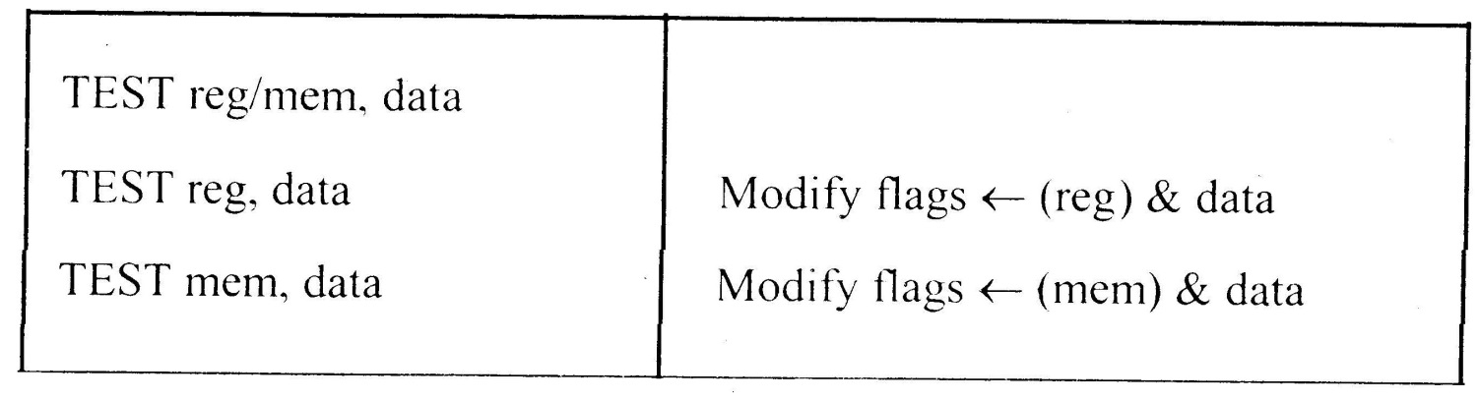
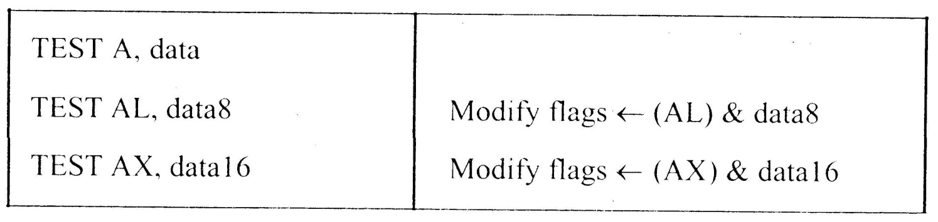
Instruction Set
8086 Microprocessor
3. Logical Instructions
Mnemonics: AND, OR, XOR, TEST, SHR, SHL, RCR, RCL …

Slide 79
Instruction Set
8086 Microprocessor
3. Logical Instructions
Mnemonics: AND, OR, XOR, TEST, SHR, SHL, RCR, RCL …

Slide 80
Instruction Set
8086 Microprocessor
3. Logical Instructions
Mnemonics: AND, OR, XOR, TEST, SHR, SHL, RCR, RCL …

Slide 81
Instruction Set
8086 Microprocessor
3. Logical Instructions
Mnemonics: AND, OR, XOR, TEST, SHR, SHL, RCR, RCL …

Slide 82
Instruction Set
8086 Microprocessor
3. Logical Instructions
Mnemonics: AND, OR, XOR, TEST, SHR, SHL, RCR, RCL …

Slide 83
Instruction Set
8086 Microprocessor
4. String Manipulation Instructions
String : Sequence of bytes or words
8086 instruction set includes instruction for string movement, comparison, scan, load and store.
REP instruction prefix : used to repeat execution of string instructions
String instructions end with S or SB or SW. S represents string, SB string byte and SW string word.
Offset or effective address of the source operand is stored in SI register and that of the destination operand is stored in DI register.
Depending on the status of DF, SI and DI registers are automatically updated.
DF = 0 ⇒ SI and DI are incremented by 1 for byte and 2 for word.
DF = 1 ⇒ SI and DI are decremented by 1 for byte and 2 for word.

Slide 84
Instruction Set
8086 Microprocessor
4. String Manipulation Instructions
Mnemonics: REP, MOVS, CMPS, SCAS, LODS, STOS
REP REPZ/ REPE (Repeat CMPS or SCAS until ZF = 0) REPNZ/ REPNE (Repeat CMPS or SCAS until ZF = 1) | While CX ≠ 0 and ZF = 1, repeat execution of string instruction and (CX) ← (CX) – 1 While CX ≠ 0 and ZF = 0, repeat execution of string instruction and (CX) ← (CX) - 1

Slide 85
Instruction Set
8086 Microprocessor
4. String Manipulation Instructions
Mnemonics: REP, MOVS, CMPS, SCAS, LODS, STOS
MOVS MOVSB MOVSW | MA = (DS) x 16₁₀ + (SI) MA_{E} = (ES) x 16₁₀ + (DI) (MA_{E}) ← (MA) If DF = 0, then (DI) ← (DI) + 1; (SI) ← (SI) + 1 If DF = 1, then (DI) ← (DI) - 1; (SI) ← (SI) - 1 MA = (DS) x 16₁₀ + (SI) MA_{E} = (ES) x 16₁₀ + (DI) (MA_{E} ; MA_{E} + 1) ← (MA; MA + 1) If DF = 0, then (DI) ← (DI) + 2; (SI) ← (SI) + 2 If DF = 1, then (DI) ← (DI) - 2; (SI) ← (SI) - 2

Slide 86
Instruction Set
8086 Microprocessor
4. String Manipulation Instructions
Mnemonics: REP, MOVS, CMPS, SCAS, LODS, STOS
Compare two string byte or string word
CMPS CMPSB CMPSW | MA = (DS) x 16₁₀ + (SI) MA_{E} = (ES) x 16₁₀ + (DI) Modify flags ← (MA) - (MA_{E}) If (MA) > (MA_{E}), then CF = 0; ZF = 0; SF = 0 If (MA) < (MA_{E}), then CF = 1; ZF = 0; SF = 1 If (MA) = (MA_{E}), then CF = 0; ZF = 1; SF = 0 For byte operation If DF = 0, then (DI) ← (DI) + 1; (SI) ← (SI) + 1 If DF = 1, then (DI) ← (DI) - 1; (SI) ← (SI) - 1 For word operation If DF = 0, then (DI) ← (DI) + 2; (SI) ← (SI) + 2 If DF = 1, then (DI) ← (DI) - 2; (SI) ← (SI) - 2

Slide 87
Instruction Set
8086 Microprocessor
4. String Manipulation Instructions
Mnemonics: REP, MOVS, CMPS, SCAS, LODS, STOS
Scan (compare) a string byte or word with accumulator
SCAS SCASB SCASW | MA_{E} = (ES) x 16₁₀ + (DI) Modify flags ← (AL) - (MA_{E}) If (AL) > (MA_{E}), then CF = 0; ZF = 0; SF = 0 If (AL) < (MA_{E}), then CF = 1; ZF = 0; SF = 1 If (AL) = (MA_{E}), then CF = 0; ZF = 1; SF = 0 If DF = 0, then (DI) ← (DI) + 1 If DF = 1, then (DI) ← (DI) – 1 MA_{E} = (ES) x 16₁₀ + (DI) Modify flags ← (AL) - (MA_{E}) If (AX) > (MA_{E} ; MA_{E} + 1), then CF = 0; ZF = 0; SF = 0 If (AX) < (MA_{E} ; MA_{E} + 1), then CF = 1; ZF = 0; SF = 1 If (AX) = (MA_{E} ; MA_{E} + 1), then CF = 0; ZF = 1; SF = 0 If DF = 0, then (DI) ← (DI) + 2 If DF = 1, then (DI) ← (DI) – 2

Slide 88
Instruction Set
8086 Microprocessor
4. String Manipulation Instructions
Mnemonics: REP, MOVS, CMPS, SCAS, LODS, STOS
Load string byte in to AL or string word in to AX
LODS LODSB LODSW | MA = (DS) x 16₁₀ + (SI) (AL) ← (MA) If DF = 0, then (SI) ← (SI) + 1 If DF = 1, then (SI) ← (SI) – 1 MA = (DS) x 16₁₀ + (SI) (AX) ← (MA ; MA + 1) If DF = 0, then (SI) ← (SI) + 2 If DF = 1, then (SI) ← (SI) – 2

Slide 89
Instruction Set
8086 Microprocessor
4. String Manipulation Instructions
Mnemonics: REP, MOVS, CMPS, SCAS, LODS, STOS
Store byte from AL or word from AX in to string
STOS STOSB STOSW | MA_{E} = (ES) x 16₁₀ + (DI) (MA_{E}) ← (AL) If DF = 0, then (DI) ← (DI) + 1 If DF = 1, then (DI) ← (DI) – 1 MA_{E} = (ES) x 16₁₀ + (DI) (MA_{E} ; MA_{E} + 1 ) ← (AX) If DF = 0, then (DI) ← (DI) + 2 If DF = 1, then (DI) ← (DI) – 2

Slide 90
Instruction Set
8086 Microprocessor
5. Processor Control Instructions
Mnemonics | Explanation
STC | Set CF ← 1
CLC | Clear CF ← 0
CMC | Complement carry CF ← CF/
STD | Set direction flag DF ← 1
CLD | Clear direction flag DF ← 0
STI | Set interrupt enable flag IF ← 1
CLI | Clear interrupt enable flag IF ← 0
NOP | No operation
HLT | Halt after interrupt is set
WAIT | Wait for TEST pin active
ESC opcode mem/ reg | Used to pass instruction to a coprocessor which shares the address and data bus with the 8086
LOCK | Lock bus during next instruction

Slide 91
Instruction Set
8086 Microprocessor
6. Control Transfer Instructions
Transfer the control to a specific destination or target instruction
Do not affect flags
8086 Unconditional transfers
Mnemonics | Explanation
CALL reg/ mem/ disp16 | Call subroutine
RET | Return from subroutine
JMP reg/ mem/ disp8/ disp16 | Unconditional jump

Slide 92
Instruction Set
8086 Microprocessor
6. Control Transfer Instructions
8086 signed conditional branch instructions
8086 unsigned conditional branch instructions
Checks flags
If conditions are true, the program control is transferred to the new memory location in the same segment by modifying the content of IP

Slide 93
Instruction Set
8086 Microprocessor
6. Control Transfer Instructions
8086 signed conditional branch instructions
8086 unsigned conditional branch instructions
Name | Alternate name
JE disp8 Jump if equal | JZ disp8 Jump if result is 0
JNE disp8 Jump if not equal | JNZ disp8 Jump if not zero
JG disp8 Jump if greater | JNLE disp8 Jump if not less or equal
JGE disp8 Jump if greater than or equal | JNL disp8 Jump if not less
JL disp8 Jump if less than | JNGE disp8 Jump if not greater than or equal
JLE disp8 Jump if less than or equal | JNG disp8 Jump if not greater
Name | Alternate name
JE disp8 Jump if equal | JZ disp8 Jump if result is 0
JNE disp8 Jump if not equal | JNZ disp8 Jump if not zero
JA disp8 Jump if above | JNBE disp8 Jump if not below or equal
JAE disp8 Jump if above or equal | JNB disp8 Jump if not below
JB disp8 Jump if below | JNAE disp8 Jump if not above or equal
JBE disp8 Jump if below or equal | JNA disp8 Jump if not above

Slide 94
Instruction Set
8086 Microprocessor
6. Control Transfer Instructions
8086 conditional branch instructions affecting individual flags
Mnemonics | Explanation
JC disp8 | Jump if CF = 1
JNC disp8 | Jump if CF = 0
JP disp8 | Jump if PF = 1
JNP disp8 | Jump if PF = 0
JO disp8 | Jump if OF = 1
JNO disp8 | Jump if OF = 0
JS disp8 | Jump if SF = 1
JNS disp8 | Jump if SF = 0
JZ disp8 | Jump if result is zero, i.e, Z = 1
JNZ disp8 | Jump if result is not zero, i.e, Z = 1

Slide 95
Assembler directives

Slide 96
Assemble Directives
8086 Microprocessor
Instructions to the Assembler regarding the program being executed.
Control the generation of machine codes and organization of the program; but no machine codes are generated for assembler directives.
Also called ‘pseudo instructions’
Used to :
› specify the start and end of a program
› attach value to variables
› allocate storage locations to input/ output data
› define start and end of segments, procedures, macros etc..

Slide 97
Assemble Directives
8086 Microprocessor
DB
DW
SEGMENT
ENDS
ASSUME
ORG
END
EVEN
EQU
PROC
FAR
NEAR
ENDP
SHORT
MACRO
ENDM
Define Byte
Define a byte type (8-bit) variable
Reserves specific amount of memory locations to each variable
Range : 00_{H} – FF_{H} for unsigned value; 00_{H} – 7F_{H} for positive value and 80_{H} – FF_{H} for negative value
General form : variable DB value/ values
Example:
LIST DB 7FH, 42H, 35H
Three consecutive memory locations are reserved for the variable LIST and each data specified in the instruction are stored as initial value in the reserved memory location

Slide 98
Assemble Directives
8086 Microprocessor
DB
DW
SEGMENT
ENDS
ASSUME
ORG
END
EVEN
EQU
PROC
FAR
NEAR
ENDP
SHORT
MACRO
ENDM
Define Word
Define a word type (16-bit) variable
Reserves two consecutive memory locations to each variable
Range : 0000_{H} – FFFF_{H} for unsigned value; 0000_{H} – 7FFF_{H} for positive value and 8000_{H} – FFFF_{H} for negative value
General form : variable DW value/ values
Example:
ALIST DW 6512H, 0F251H, 0CDE2H
Six consecutive memory locations are reserved for the variable ALIST and each 16-bit data specified in the instruction is stored in two consecutive memory location.

Slide 99
Assemble Directives
8086 Microprocessor
DB
DW
SEGMENT
ENDS
ASSUME
ORG
END
EVEN
EQU
PROC
FAR
NEAR
ENDP
SHORT
MACRO
ENDM
SEGMENT : Used to indicate the beginning of a code/ data/ stack segment
ENDS : Used to indicate the end of a code/ data/ stack segment
General form:
Segnam SEGMENT … … … … … … Segnam ENDS | Program code or Data Defining Statements
User defined name of the segment

Slide 100
Assemble Directives
8086 Microprocessor
DB
DW
SEGMENT
ENDS
ASSUME
ORG
END
EVEN
EQU
PROC
FAR
NEAR
ENDP
SHORT
MACRO
ENDM
Informs the assembler the name of the program/ data segment that should be used for a specific segment.
General form:
ASSUME segreg : segnam, .. , segreg : segnam
Segment Register
User defined name of the segment
Example:
ASSUME CS: ACODE, DS:ADATA | Tells the compiler that the instructions of the program are stored in the segment ACODE and data are stored in the segment ADATA

Slide 101
Assemble Directives
8086 Microprocessor
DB
DW
SEGMENT
ENDS
ASSUME
ORG
END
EVEN
EQU
PROC
FAR
NEAR
ENDP
SHORT
MACRO
ENDM
ORG (Origin) is used to assign the starting address (Effective address) for a program/ data segment
END is used to terminate a program; statements after END will be ignored
EVEN : Informs the assembler to store program/ data segment starting from an even address
EQU (Equate) is used to attach a value to a variable
Examples:
ORG 1000H | Informs the assembler that the statements following ORG 1000H should be stored in memory starting with effective address 1000_{H}
LOOP EQU 10FEH | Value of variable LOOP is 10FE_{H}
_SDATA SEGMENT ORG 1200H A DB 4CH EVEN B DW 1052H _SDATA ENDS | In this data segment, effective address of memory location assigned to A will be 1200_{H} and that of B will be 1202_{H} and 1203_{H}.

Slide 102
Assemble Directives
8086 Microprocessor
DB
DW
SEGMENT
ENDS
ASSUME
ORG
END
EVEN
EQU
PROC
ENDP
FAR
NEAR
SHORT
MACRO
ENDM
PROC Indicates the beginning of a procedure
ENDP End of procedure
FAR Intersegment call
NEAR Intrasegment call
General form
procname PROC[NEAR/ FAR] … … … RET procname ENDP | Program statements of the procedure Last statement of the procedure
User defined name of the procedure

Slide 103
Assemble Directives
8086 Microprocessor
DB
DW
SEGMENT
ENDS
ASSUME
ORG
END
EVEN
EQU
PROC
ENDP
FAR
NEAR
SHORT
MACRO
ENDM
Examples:
ADD64 PROC NEAR … … … RET ADD64 ENDP | The subroutine/ procedure named ADD64 is declared as NEAR and so the assembler will code the CALL and RET instructions involved in this procedure as near call and return
CONVERT PROC FAR … … … RET CONVERT ENDP | The subroutine/ procedure named CONVERT is declared as FAR and so the assembler will code the CALL and RET instructions involved in this procedure as far call and return

Slide 104
Assemble Directives
8086 Microprocessor
DB
DW
SEGMENT
ENDS
ASSUME
ORG
END
EVEN
EQU
PROC
ENDP
FAR
NEAR
SHORT
MACRO
ENDM
Reserves one memory location for 8-bit signed displacement in jump instructions
Example:
JMP SHORT AHEAD | The directive will reserve one memory location for 8-bit displacement named AHEAD

Slide 105
Assemble Directives
8086 Microprocessor
DB
DW
SEGMENT
ENDS
ASSUME
ORG
END
EVEN
EQU
PROC
ENDP
FAR
NEAR
SHORT
MACRO
ENDM
MACRO Indicate the beginning of a macro
ENDM End of a macro
General form:
macroname MACRO[Arg1, Arg2 ...] … … … macroname ENDM | Program statements in the macro
User defined name of the macro

Slide 106
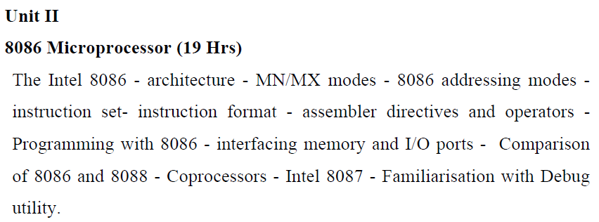

Slide 107
Interfacing memory and i/o ports

Slide 108
Memory
8086 Microprocessor
Processor Memory
Registers inside a microcomputer
Store data and results temporarily
No speed disparity
Cost ↑
Primary or Main Memory
Memory
Storage area which can be directly accessed by microprocessor
Store programs and data prior to execution
Should not have speed disparity with processor ⇒ Semi Conductor memories using CMOS technology
ROM, EPROM, Static RAM, DRAM
Store Programs and Data
Secondary Memory
Storage media comprising of slow devices such as magnetic tapes and disks
Hold large data files and programs: Operating system, compilers, databases, permanent programs etc.

Slide 109
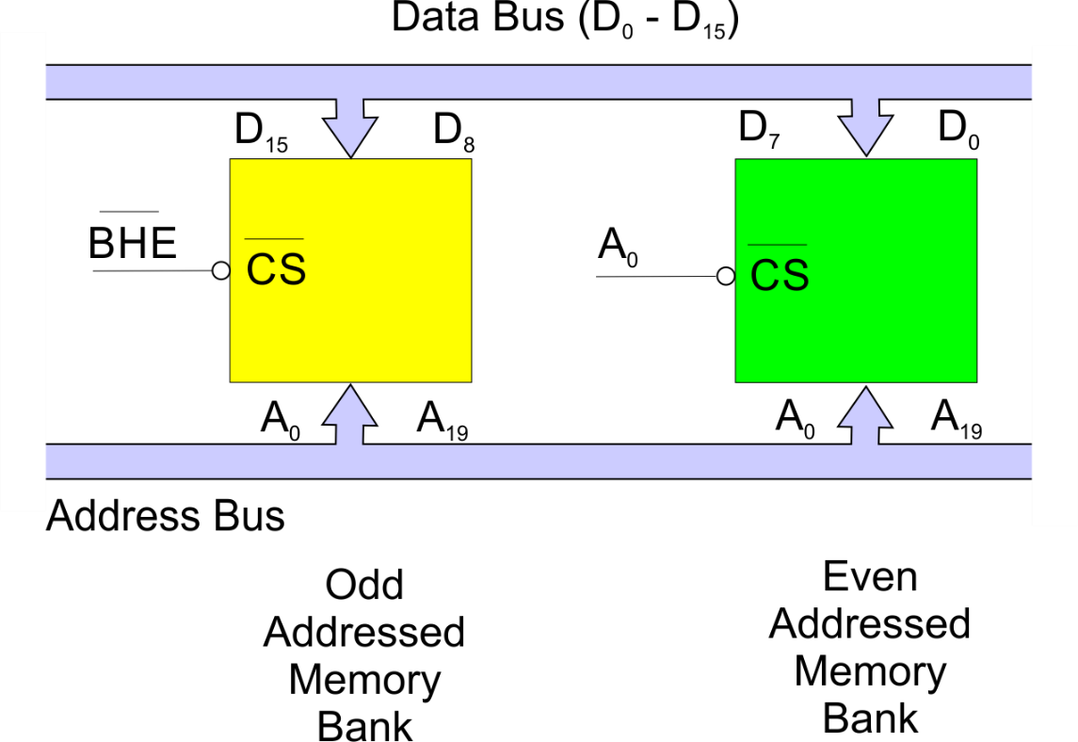
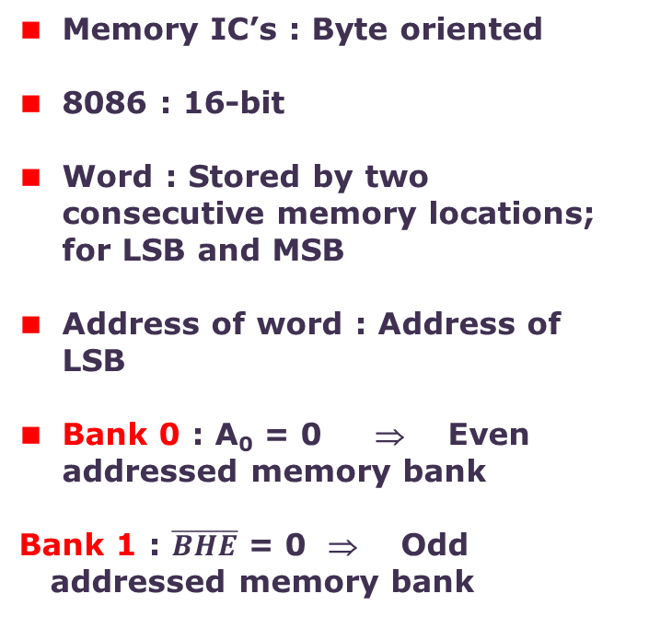
Memory organization in 8086
8086 Microprocessor
Memory IC’s : Byte oriented
8086 : 16-bit
Word : Stored by two consecutive memory locations; for LSB and MSB
Address of word : Address of LSB
Bank 0 : A₀ = 0 ⇒ Even addressed memory bank
Bank 1 : $\overline{BHE}$ = 0 ⇒ Odd
addressed memory bank

Slide 110

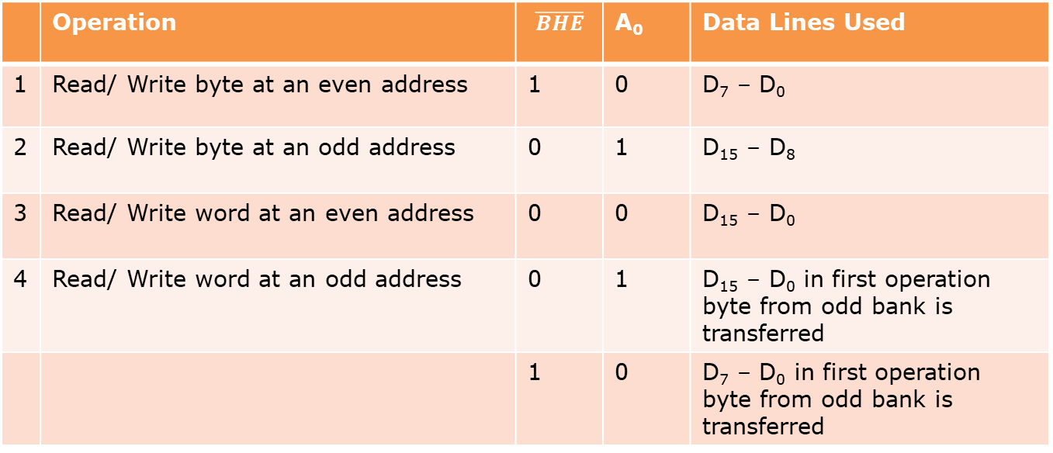
Memory organization in 8086
8086 Microprocessor
 | Operation | $$\overline{BHE}$$ | A₀ | Data Lines Used
1 | Read/ Write byte at an even address | 1 | 0 | D₇ – D₀
2 | Read/ Write byte at an odd address | 0 | 1 | D₁₅ – D₈
3 | Read/ Write word at an even address | 0 | 0 | D₁₅ – D₀
4 | Read/ Write word at an odd address | 0 | 1 | D₁₅ – D₀ in first operation byte from odd bank is transferred
 |  | 1 | 0 | D₇ – D₀ in first operation byte from odd bank is transferred

Slide 111
Memory organization in 8086
8086 Microprocessor
Available memory space = EPROM + RAM
Allot equal address space in odd and even bank for both EPROM and RAM
Can be implemented in two IC’s (one for even and other for odd) or in multiple IC’s

Slide 112
Interfacing SRAM and EPROM
8086 Microprocessor
Memory interface ⇒ Read from and write in to a set of semiconductor memory IC chip
EPROM ⇒ Read operations
RAM ⇒ Read and Write
In order to perform read/ write operations,
Memory access time < read / write time of the processor
Chip Select (CS) signal has to be generated
Control signals for read / write operations
Allot address for each memory location

Slide 113
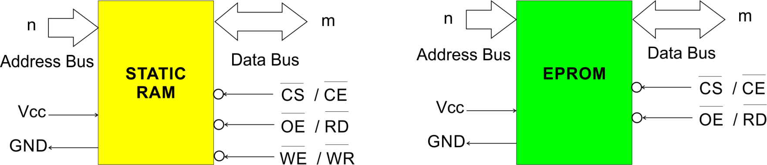
Interfacing SRAM and EPROM
8086 Microprocessor
Typical Semiconductor IC Chip
No of Address pins | Memory capacity |  |  | Range of address in hexa
 | In Decimal | In kilo | In hexa
20 | 2²⁰= 10,48,576 | 1024 k = 1M | 100000 | 00000 to FFFFF

Slide 114
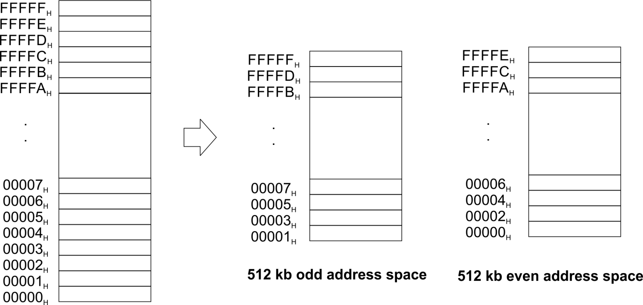
Interfacing SRAM and EPROM
8086 Microprocessor
Memory map of 8086
EPROM’s are mapped at FFFFF_{H}
⇒ Facilitate automatic execution of monitor programs and creation of interrupt vector table
RAM are mapped at the beginning; 00000H is allotted to RAM

Slide 115
Interfacing SRAM and EPROM
8086 Microprocessor
Monitor Programs
⇒ Programing 8279 for keyboard scanning and display refreshing
⇒ Programming peripheral IC’s 8259, 8257, 8255, 8251, 8254 etc
⇒ Initialization of stack
⇒ Display a message on display (output)
⇒ Initializing interrupt vector table
Note :
8279 | Programmable keyboard/ display controller
8257 | DMA controller
8259 | Programmable interrupt controller
8255 | Programmable peripheral interface

Slide 116
Interfacing I/O and peripheral devices
8086 Microprocessor
I/O devices
⇒ For communication between microprocessor and outside world
⇒ Keyboards, CRT displays, Printers, Compact Discs etc.
⇒
⇒ Data transfer types
Microprocessor
Ports / Buffer IC’s
(interface circuitry)
I/ O devices
Memory mapped
I/O mapped
Programmed I/ O
Data transfer is accomplished through an I/O port controlled by software
Interrupt driven I/ O
    I/O device interrupts the processor and initiate data transfer
Direct memory access
    Data transfer is achieved by bypassing the microprocessor

Slide 117
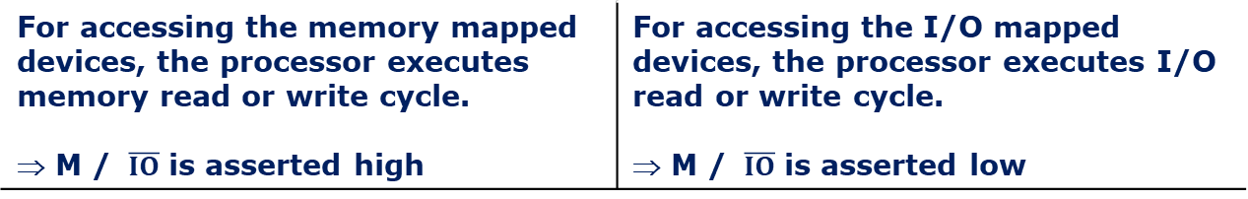
8086 and 8088 comparison
8086 Microprocessor
Memory mapping | I/O mapping
20 bit address are provided for I/O devices | 8-bit or 16-bit addresses are provided for I/O devices
The I/O ports or peripherals can be treated like memory locations and so all instructions related to memory can be used for data transmission between I/O device and processor | Only IN and OUT instructions can be used for data transfer between I/O device and processor
Data can be moved from any register to ports and vice versa | Data transfer takes place only between accumulator and ports
When memory mapping is used for I/O devices, full memory address space cannot be used for addressing memory. ⇒ Useful only for small systems where memory requirement is less | Full memory space can be used for addressing memory. ⇒ Suitable for systems which require large memory capacity
For accessing the memory mapped devices, the processor executes memory read or write cycle. ⇒ M / $\overline{IO}$ is asserted high | For accessing the I/O mapped devices, the processor executes I/O read or write cycle. ⇒ M / $\overline{IO}$ is asserted low

Slide 118
8086 and 8088 comparison

Slide 119
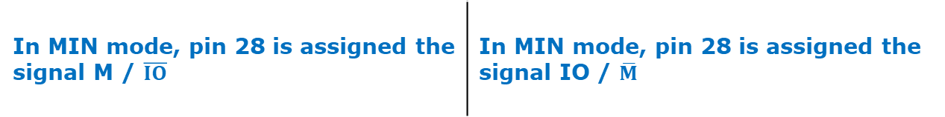

8086 and 8088 comparison
8086 Microprocessor
8086 | 8088
Similar EU and Instruction set ; dissimilar BIU
16-bit Data bus lines obtained by demultiplexing AD₀ – AD₁₅ | 8-bit Data bus lines obtained by demultiplexing AD₀ – AD₇
20-bit address bus | 8-bit address bus
Two banks of memory each of 512 kb | Single memory bank
6-bit instruction queue | 4-bit instruction queue
Clock speeds: 5 / 8 / 10 MHz | 5 / 8 MHz
In MIN mode, pin 28 is assigned the signal M / $\overline{IO}$ | In MIN mode, pin 28 is assigned the signal IO / $\overline{M}$
To access higher byte, $\overline{BHE}$ signal is used | No such signal required, since the data width is only 1-byte

Slide 120
8087 Coprocessor

Slide 121
Co-processor – Intel 8087
8086 Microprocessor
Multiprocessor
system
A microprocessor system comprising of two or more processors
Distributed processing: Entire task is divided in to subtasks
Advantages
Better system throughput by having more than one processor
Each processor have a local bus to access local memory or I/O devices so that a greater degree of parallel processing can be achieved
System structure is more flexible. One can easily add or remove modules to change the system configuration without affecting the other modules in the system

Slide 122
Co-processor – Intel 8087
8086 Microprocessor
8087
coprocessor
Specially designed to take care of mathematical calculations involving integer and floating point data
“Math coprocessor” or “Numeric Data Processor (NDP)”
Works in parallel with a 8086 in the maximum mode
Features
Can operate on data of the integer, decimal and real types with lengths ranging from 2 to 10 bytes
Instruction set involves square root, exponential, tangent etc. in addition to addition, subtraction, multiplication and division.
High performance numeric data processor ⇒ it can multiply two 64-bit real numbers in about 27μs and calculate square root in about 36 μs
Follows IEEE floating point standard
It is multi bus compatible

Slide 123
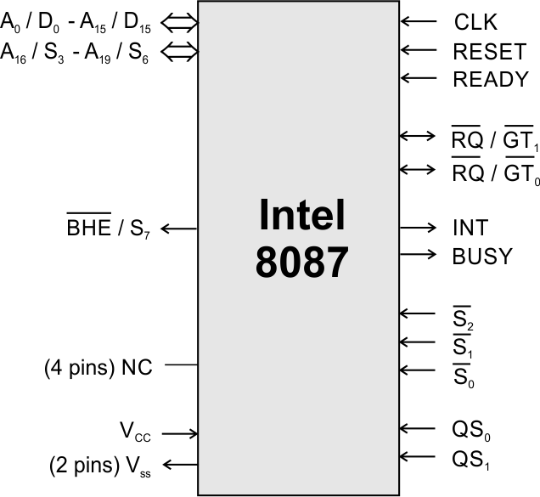
Co-processor – Intel 8087
8086 Microprocessor
16 multiplexed address / data pins and 4 multiplexed address / status pins
Hence it can have 16-bit external data bus and 20-bit external address bus like 8086
Processor clock, ready and reset signals are applied as clock, ready and reset signals for coprocessor

Slide 124
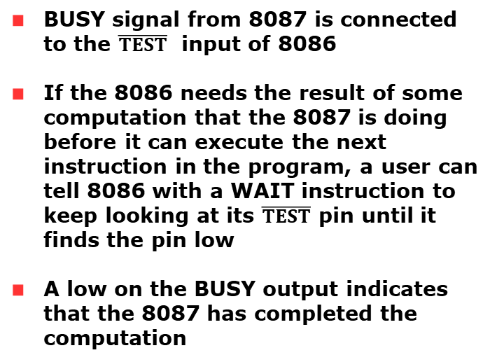
Co-processor – Intel 8087
8086 Microprocessor
BUSY
BUSY signal from 8087 is connected to the $\overline{TEST}$ input of 8086
If the 8086 needs the result of some computation that the 8087 is doing before it can execute the next instruction in the program, a user can tell 8086 with a WAIT instruction to keep looking at its $\overline{TEST}$ pin until it finds the pin low
A low on the BUSY output indicates that the 8087 has completed the computation

Slide 125


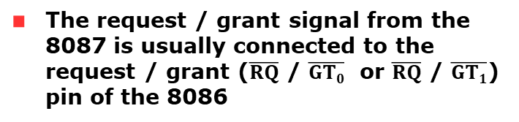
Co-processor – Intel 8087
8086 Microprocessor
$\overline{RQ}$ / $\overline{GT0}$
The request / grant signal from the 8087 is usually connected to the request / grant ($\overline{RQ}$ / $\overline{GT0}$ or $\overline{RQ}$ / $\overline{GT1}$) pin of the 8086
$\overline{RQ}$ / $\overline{GT1}$
The request / grant signal from the 8087 is usually connected to the request / grant pin of the independent processor such as 8089

Slide 126
Co-processor – Intel 8087
8086 Microprocessor
INT
The interrupt pin is connected to the interrupt management logic.
The 8087 can interrupt the 8086 through this interrupt management logic at the time error condition exists

Slide 127
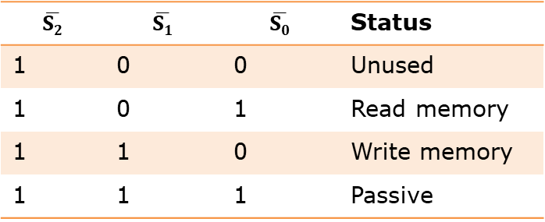

Co-processor – Intel 8087
8086 Microprocessor
$\overline{S0}$- $\overline{S}2$
$$\overline{S2}$$ | $$\overline{S1}$$ | $$\overline{S0}$$ | Status
1 | 0 | 0 | Unused
1 | 0 | 1 | Read memory
1 | 1 | 0 | Write memory
1 | 1 | 1 | Passive
QS₀ – QS₁
QS₀ | QS₁ | Status
0 | 0 | No operation
0 | 1 | First byte of opcode from queue
1 | 0 | Queue empty
1 | 1 | Subsequent byte of opcode from queue

Slide 128
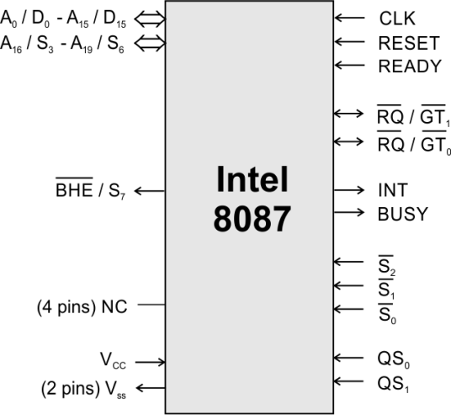
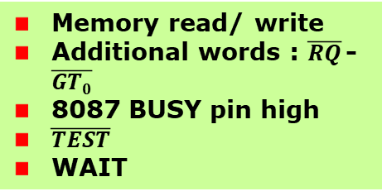
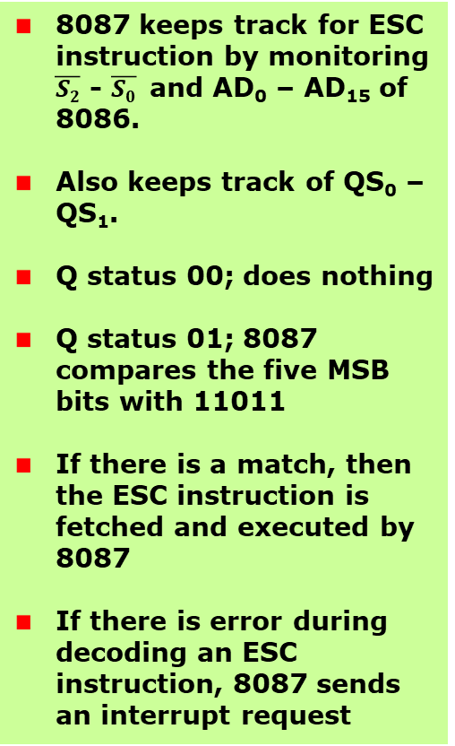
Co-processor – Intel 8087
8086 Microprocessor
8086 and 8087 reads instruction bytes and puts them in the respective queues
NOP
8087 instructions have 11011 as the MSB of their first code byte
8087 keeps track for ESC instruction by monitoring $\overline{S2}$ - $\overline{S0}$ and AD₀ – AD₁₅ of 8086.
Also keeps track of QS₀ – QS₁.
Q status 00; does nothing
Q status 01; 8087 compares the five MSB bits with 11011
If there is a match, then the ESC instruction is fetched and executed by 8087
If there is error during decoding an ESC instruction, 8087 sends an interrupt request
8087 instructions are inserted in the 8086 program
Memory read/ write
Additional words : $\overline{RQ}$- $\overline{GT0}$
8087 BUSY pin high
$\overline{TEST}$
WAIT
Ref: Microprocessor, Atul P. Godse, Deepali A. Gode, Technical publications, Chap 11

Slide 129
Co-processor – Intel 8087
8086 Microprocessor
8086/ 8088
Coprocessor
Wake up the coprocessor
ESC
Monitor 8086/ 8088
Deactivate the host’s TEST pin and execute the specific operation
Execute the 8086 instructions
WAIT
Activate the TEST pin
Wake up the 8086/ 8088

